Slide 1
Vending Machine Controller
Hardware Engineering Lab
Summer Term 2025
Team J
Younsuk Choi, Yuming (Leano) Wang, Muhammad Emaan Sajid
2025.06.24
Page 1

Slide 2
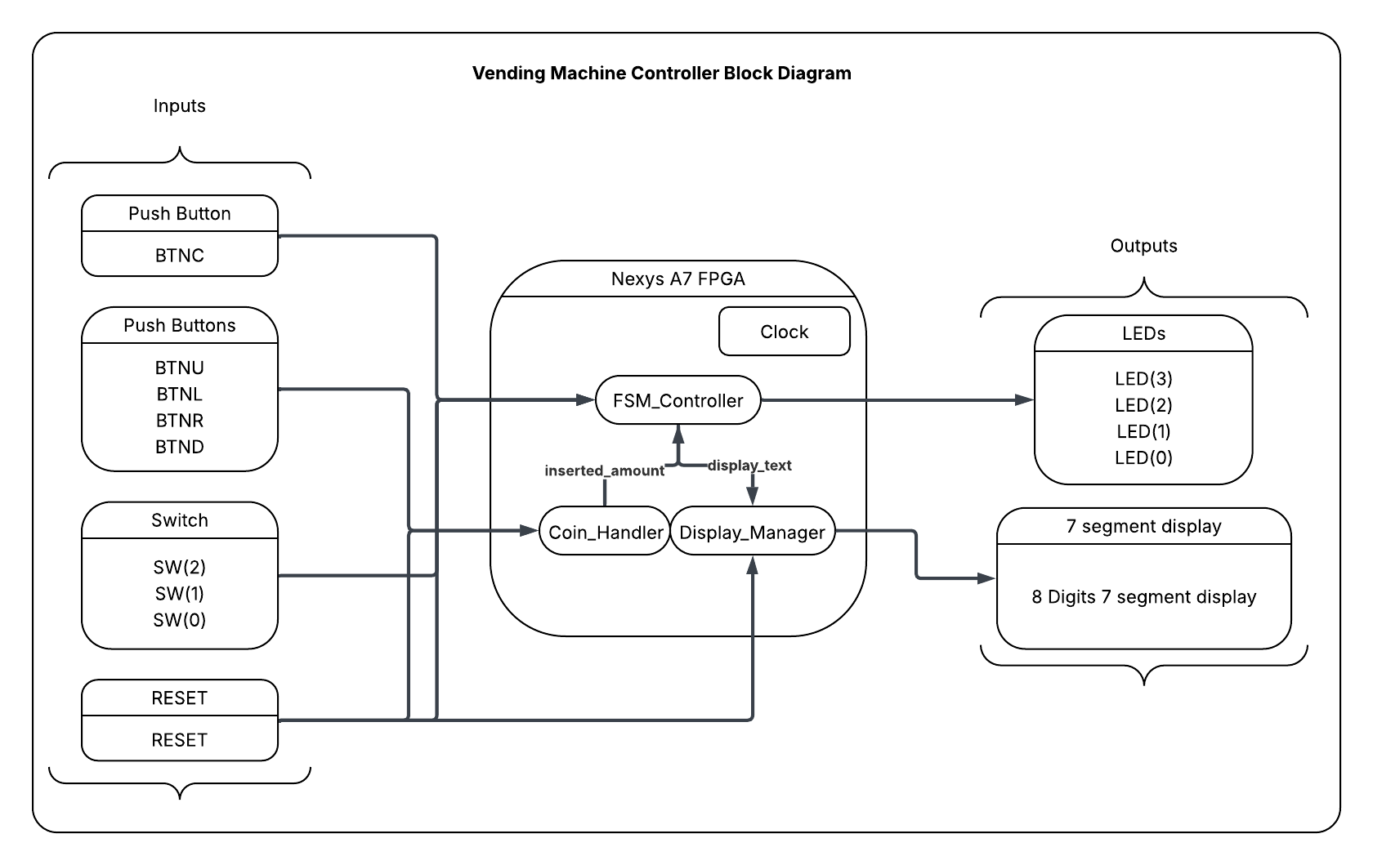
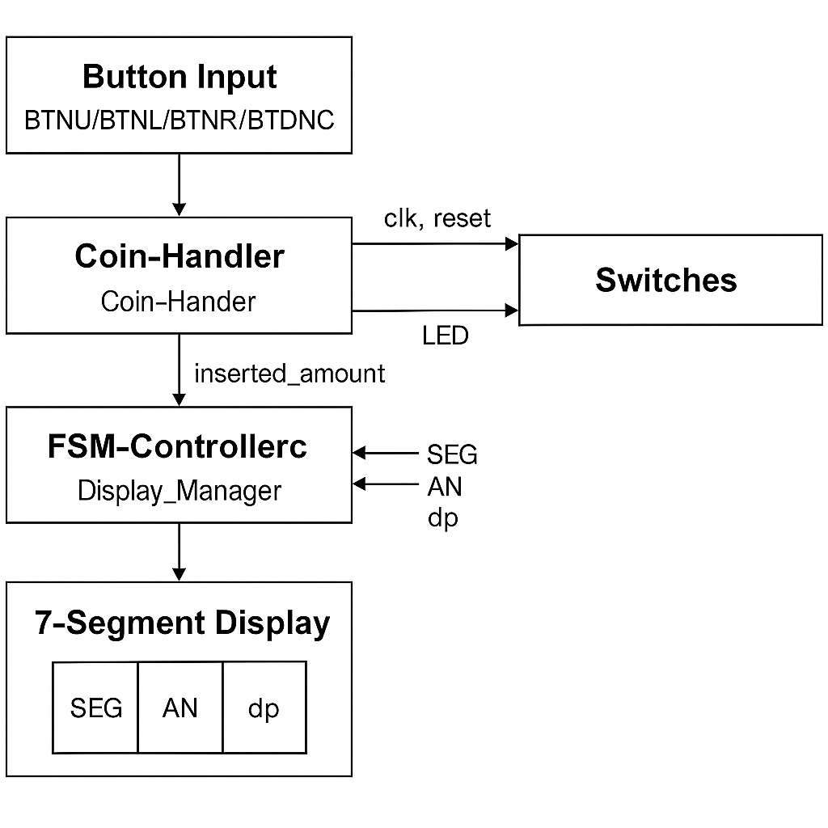
Concepts with diagrams_block diagram
Hardware Engineering Lab
Summer Term 2025
Selection of items using switches
Display the names and the prices of the items using 8 digits of seven segment display
Insertion coins using push buttons
Display the inserted coin amounts using 8 digits of seven segment display
Display the current state using LEDs
Page 2

Slide 3
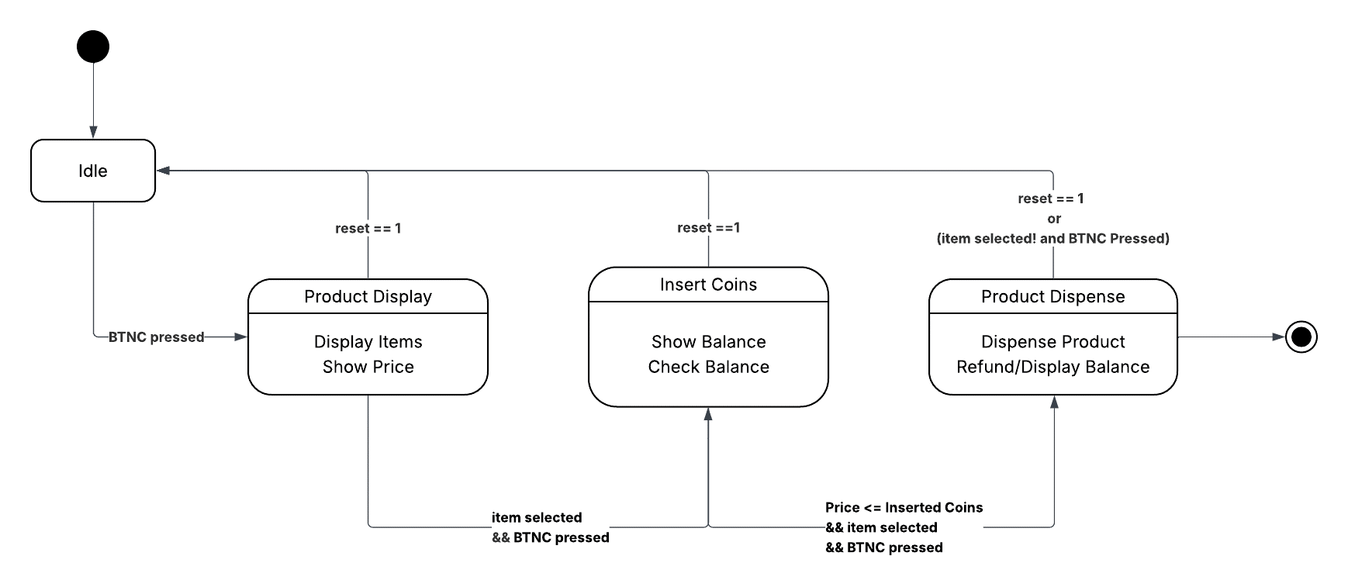
Concepts with diagrams_state machine diagram
Hardware Engineering Lab
Summer Term 2025
Page 3

Slide 4
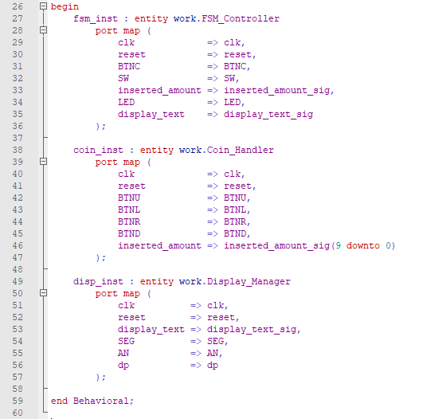
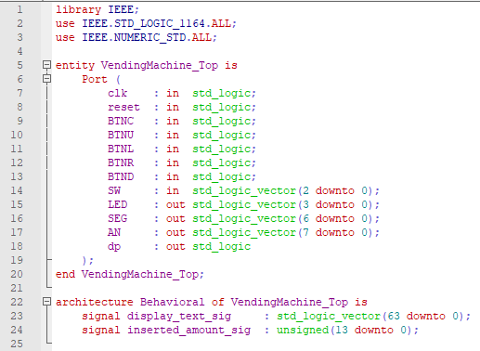
VHDL Code Implementations
VendingMachine_Top.vhd
Hardware Engineering Lab
Summer Term 2025
Page 4

Slide 5
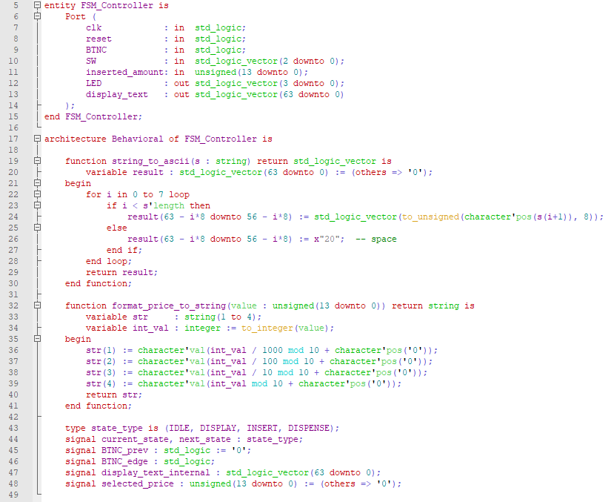
VHDL Code Implementations
FSM_Controller.vhd
Part 1
Hardware Engineering Lab
Summer Term 2025
string_to_ascii
converts 8-characters string to a 64-bit std_logic_vector
format_price_to_string
converts 14-bit unsigned integer(cents) to 4-digit ASCII character string
Page 5

Slide 6
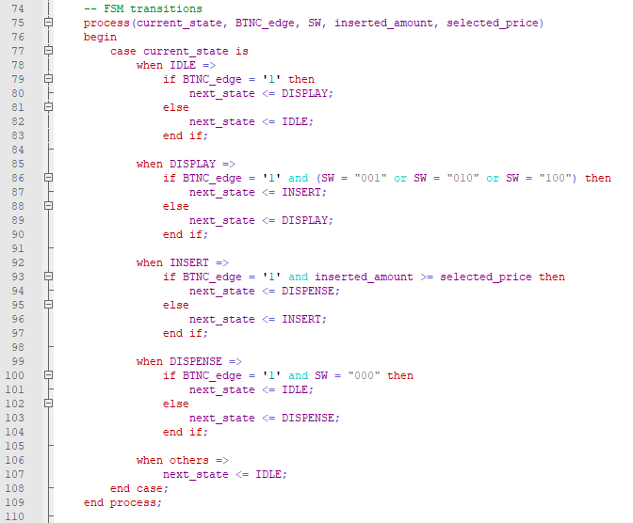
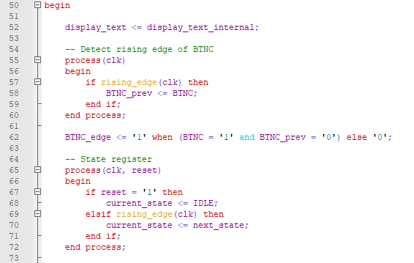
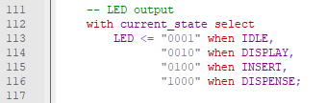
VHDL Code Implementations
FSM_Controller.vhd
Part 2_processes
Hardware Engineering Lab
Summer Term 2025
Moore’s FSM
Page 6

Slide 7
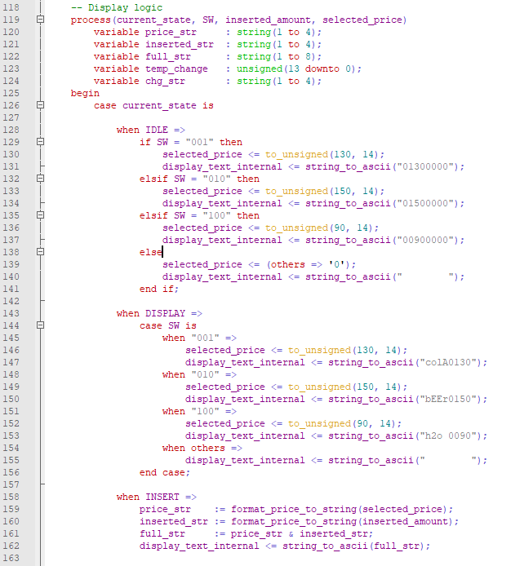
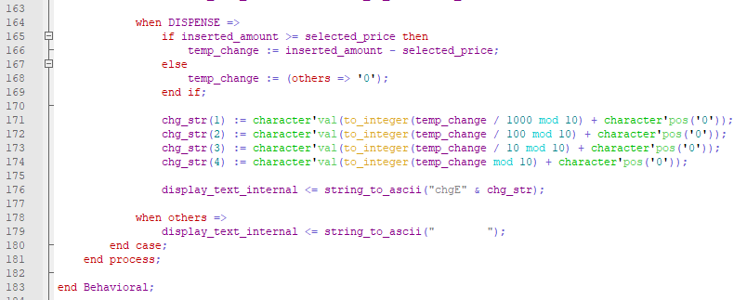
VHDL Code Implementations
FSM_Controller.vhd Part 3_Process
Hardware Engineering Lab
Summer Term 2025
Page 7

Slide 8
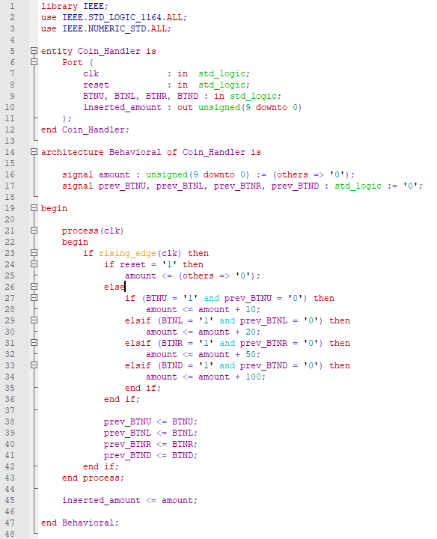
VHDL Code Implementations
Coin_Handler.vhd
Hardware Engineering Lab
Summer Term 2025
Page 8

Slide 9
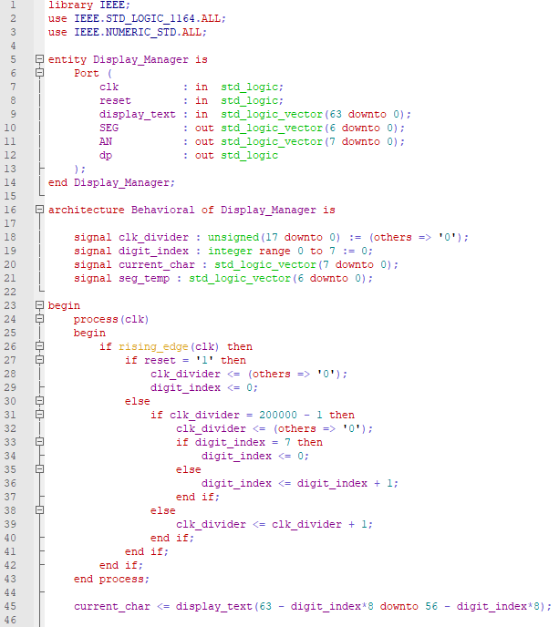
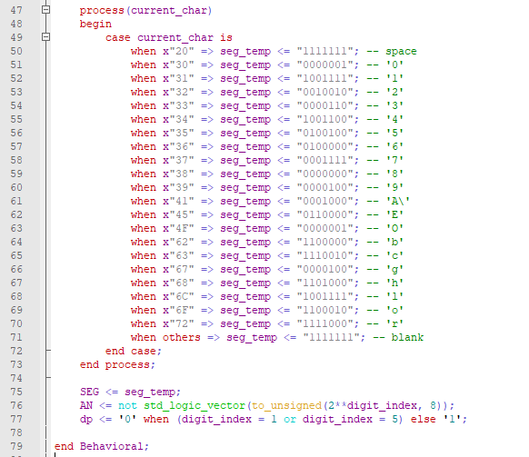
VHDL Code Implementations
Display_Manager.vhd
Hardware Engineering Lab
Summer Term 2025
Page 9

Slide 10
Verification with Test Benches_Results:FSM_Controller
Hardware Engineering Lab
Summer Term 2025
One hot coding
Test Cases:
Test case 1: Check if the state transitions from IDLE to DISPLAY when the BTNC is pressed
Test case 2: Check if the state transitions from DISPLAY to INSERT when no switch is selected
Test case 3: Check if the state transitions from DISPLAY to INSERT when switch 1 is selected
Test case 4: Check if the state transitions from INSERT to DISPENSE when inserted amount is lower than the price of the item
Test case 5: Check if the state transitions from INSERT to DISPENSE when inserted amount is greater or equal to the price of the item
Test case 6: Check if the state transitions from DISPENSE to IDLE when a switch is still on
Test case 7: Check if the state transitions from DISPENSE to IDLE when a switch is finally off.
Test case 8: Check if the state transitions from IDLE to DISPLAY when the BTNC is pressed.
Test case 9: Check if the item 1 is displayed correctly if the SW(0) is on. (SW_tb = “001”)
Test case 10: Check if the item 2 is displayed correctly if the SW(1) is on. (SW_tb = “010”)
Test case 11: Check if the item 3 is displayed correctly if the SW(2) is on. (SW_tb = “100”)
Test case 12: Check if the inserted amount (50) is correctly being displayed on the right 4 digits of 7 segment display.
Test case 13: Check if the inserted amount (150) allows state transition to DISPENSE and the correct change is displayed on the 7 segment display.
Test case 14: Check if the state transitions from DISPENSE to IDLE when a switch is still on.
Test case 15: Check if the state transitions from DISPENSE to IDLE when the switch is finally off.
Page 10

Slide 11
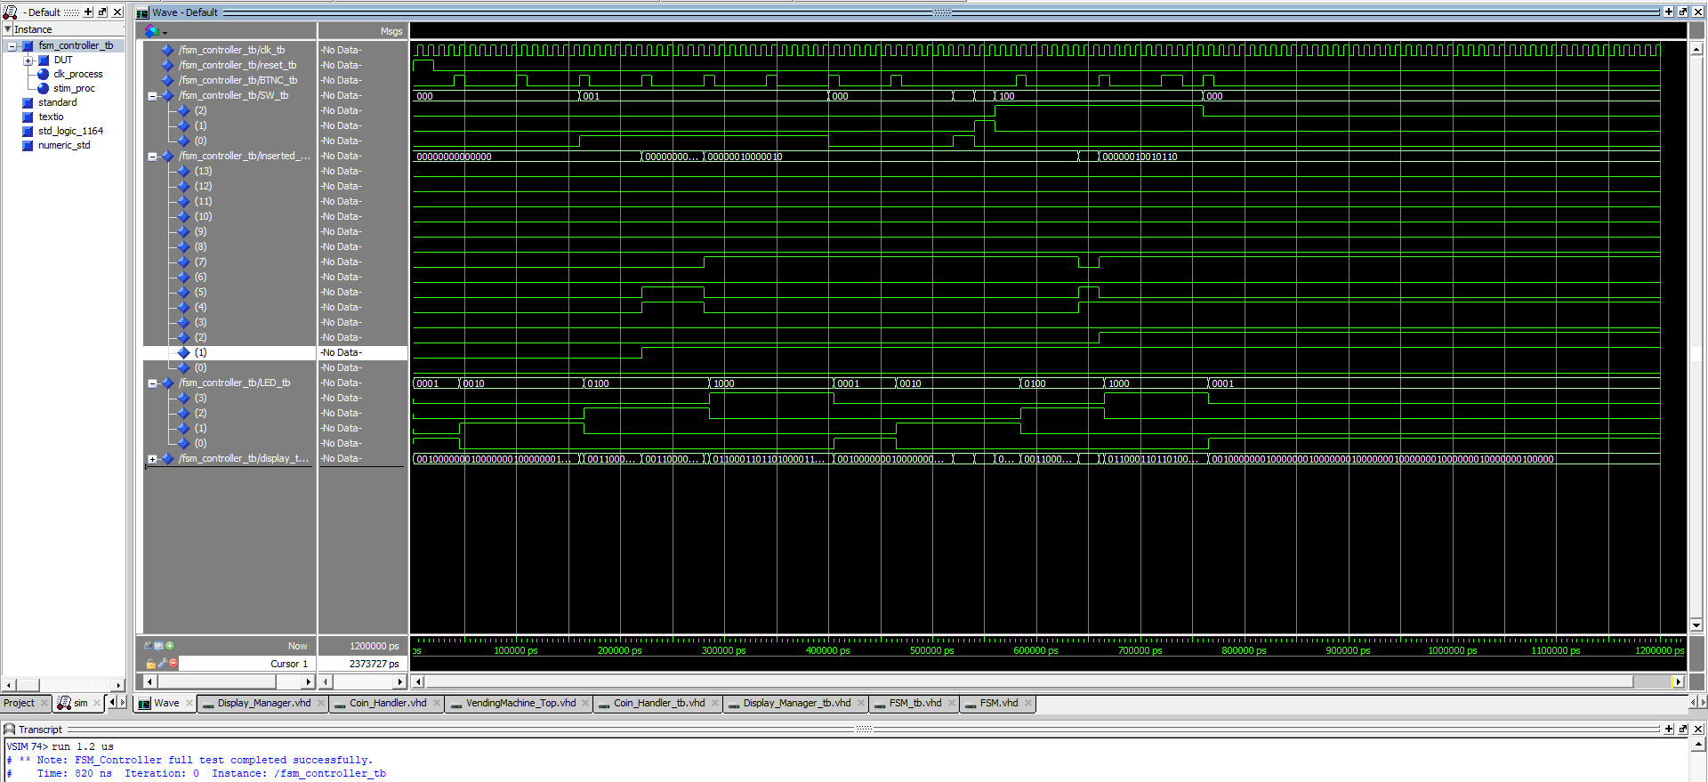
Test Benches_Results:FSM_Controller
Hardware Engineering Lab
Summer Term 2025
Page 10

Slide 12
Verification with Test Benches_Results:Coin_Handler
Hardware Engineering Lab
Summer Term 2025
Test Cases:
‘01234567’
‘89 AEObc’
‘ghlor ’
‘colA0130’
‘bEEr0150’
‘h2o 0090’
Page 12

Slide 13
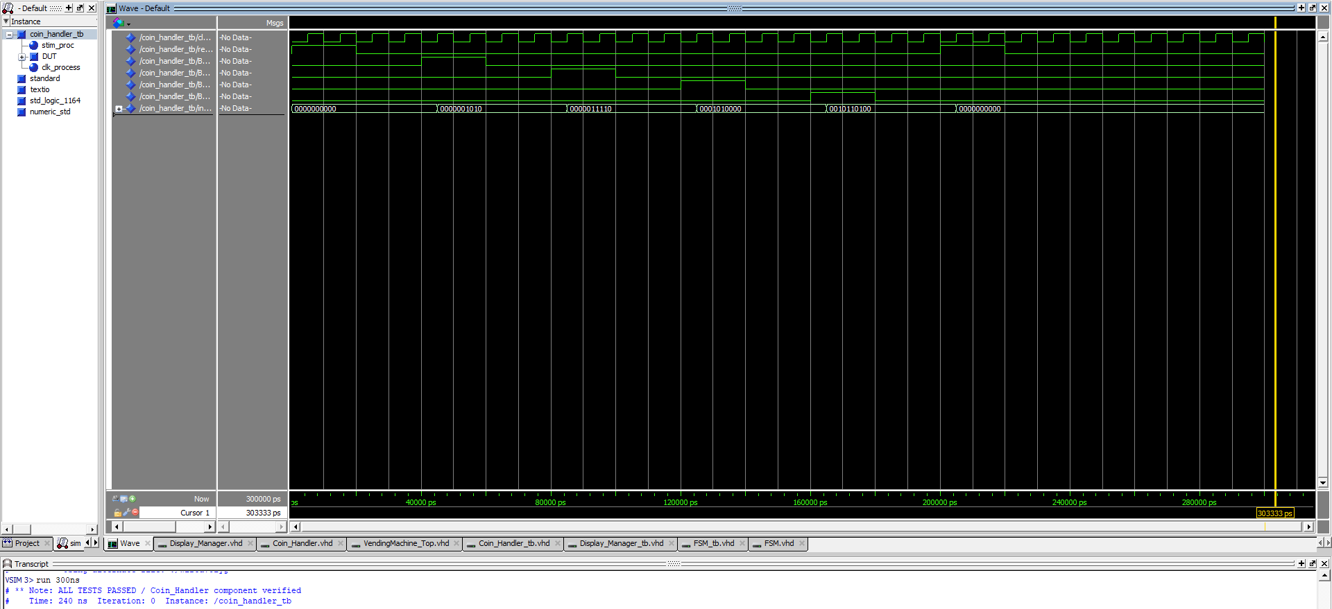
Test Benches_Results:Coin_Handler
Hardware Engineering Lab
Summer Term 2025
Page 11

Slide 14
Verification with Test Benches_Results:Display_Manager
Hardware Engineering Lab
Summer Term 2025
Test Cases:
Insert 10 cents and see if the inserted amount is 10 cents
Insert 20 cents and see if the inserted amount is 30 cents
Insert 50 cents and see if the inserted amount is 80 cents
Insert 100 cents = 1 euro and see if the inserted amount is 180 cents
Reset the test
Page 14

Slide 15
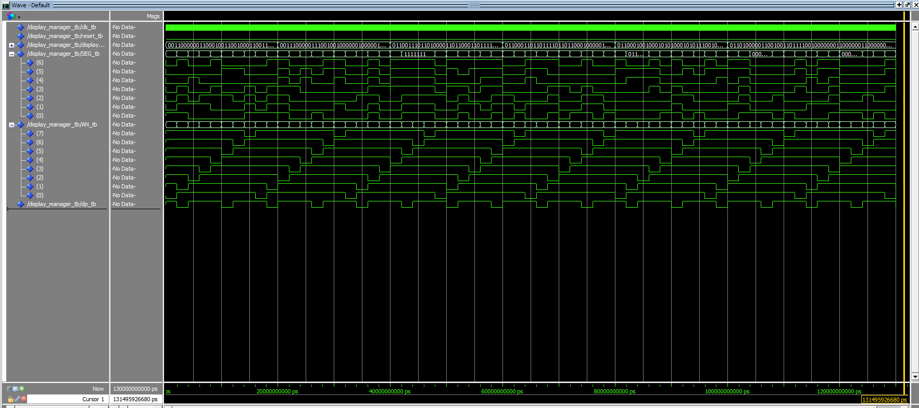
Test Benches_Results:Display_Manager
Hardware Engineering Lab
Summer Term 2025
Page 12

Slide 16
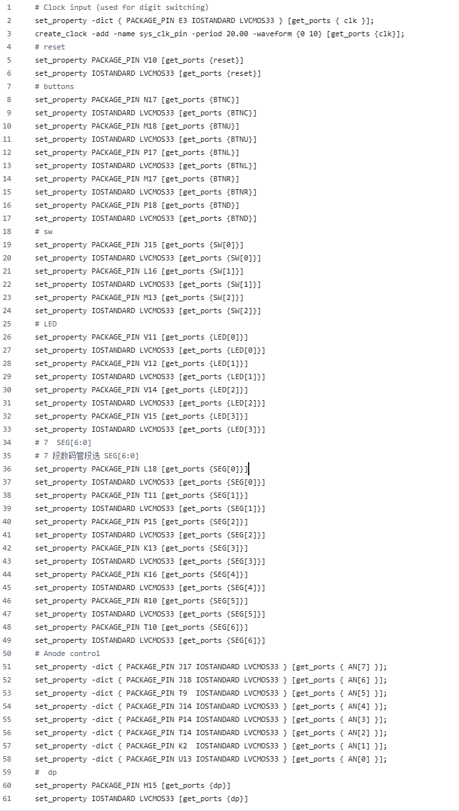
FPGA Implementations_constraint file
Hardware Engineering Lab
Summer Term 2025
Page 16

Slide 17
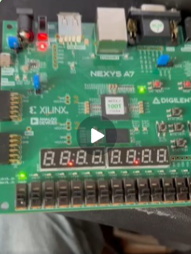
FPGA Simulations
Hardware Engineering Lab
Summer Term 2025
Videos
Simulation in Real Time
Page 17

Slide 18
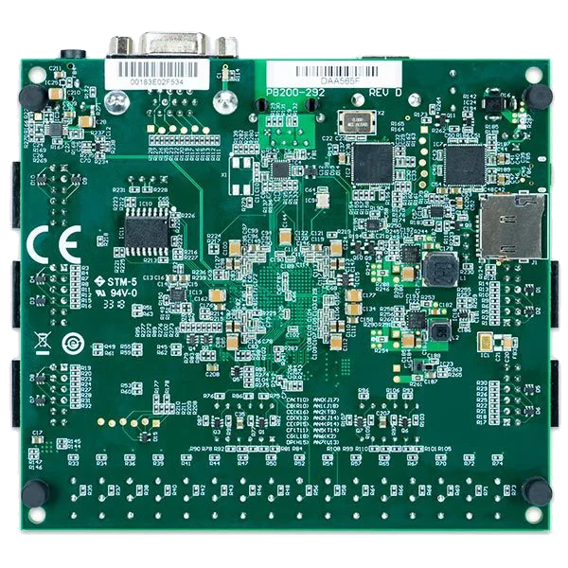
PCB Prototyping
Hardware Engineering Lab
Summer Term 2025
PCB design is a process of designing printed circuit boards in which we electrically connect electronic components. Some known process of PCB Design
Find requirement according the target group or client
Select the design tools
Schematics drawing
Components placements
Routing
Design Rules Check
Gerber file generation
Simulation and testing
Prototyping
Final production
Page 18

Slide 19
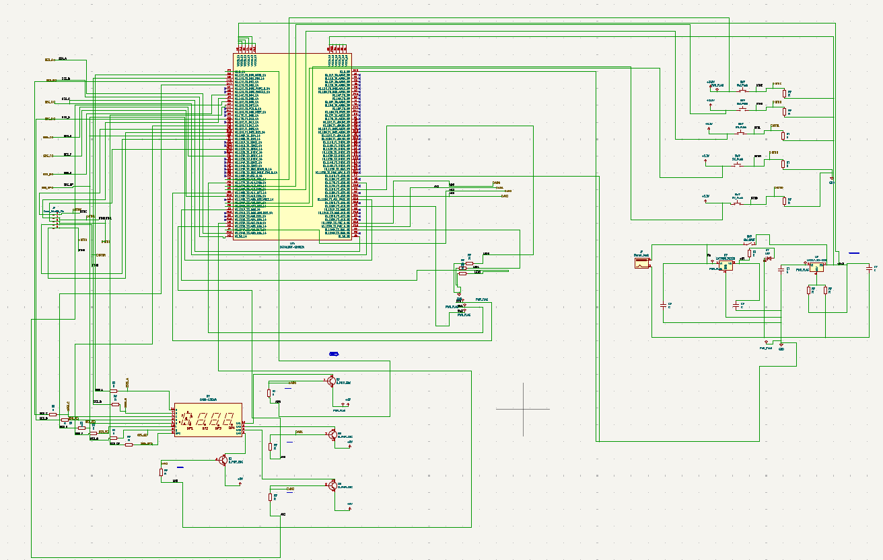
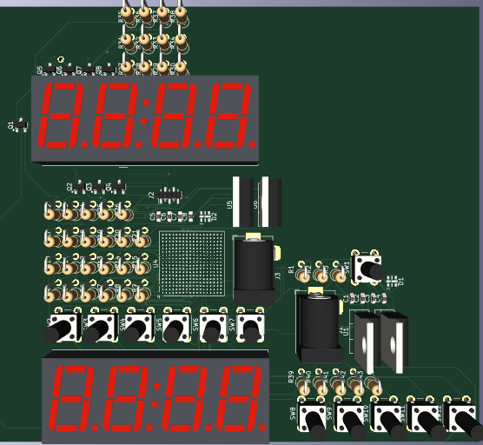
PCB Prototyping
Hardware Engineering Lab
Summer Term 2025
After discussion and deep analysis we select these elements for our PCB
Two 7 segment display
power supply
Resistors and Capacitors
Central component is the Nexus A7 XC7A100T FPGA, handling all control logic and I/O
Connected to multiple push buttons for item selection and user interaction.
PNP and NPN transistors control outputs like relays or motors, acting as switches via FPGA signals.
Schematics
3D View
Page 19
Schematics

Slide 20
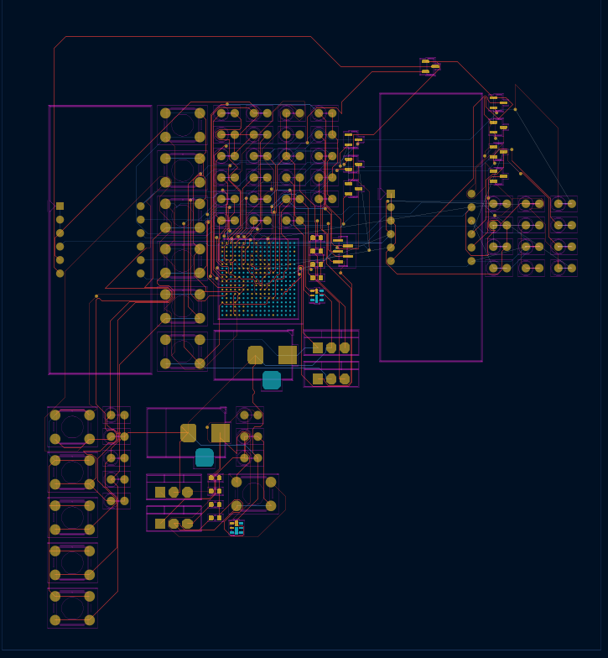
PCB Prototyping
Hardware Engineering Lab
Summer Term 2025
Our custom PCB Board Design Process
I did follow some steps to creating our custom PCB
Initially I did install Kicad 9.0 for designing
I did create a folder for save our custom board.
I start add components from library to schematics
After complete schematics then I start routing
I added external plugin for auto routing like freerouting
I added some connection manually
I am able to see the nice 3D view of custom PCB
Now I am able to generate Gerber file
Fig: PCB Layout
Page 20

Slide 21
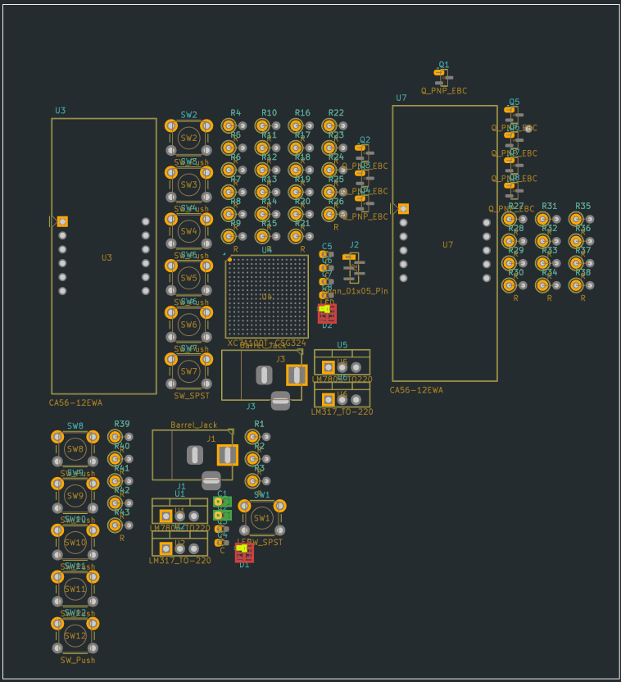
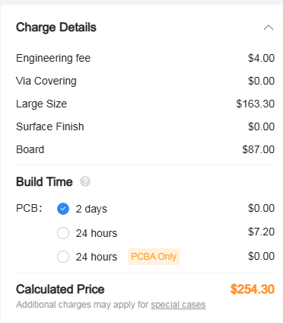
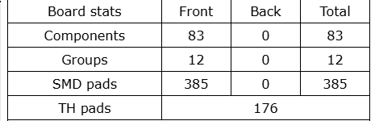
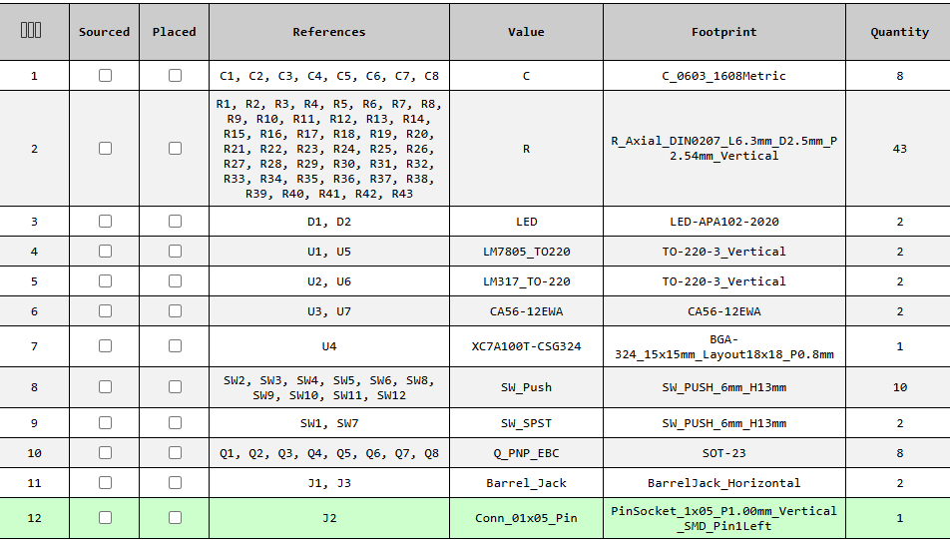
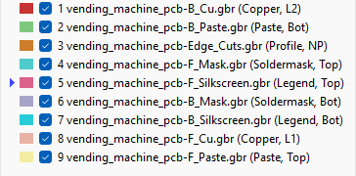
BOM Cost and Gerber files
Hardware Engineering Lab
Summer Term 2025
BOM stands for Bill of Material that:
Is a detailed list of all components used in the PCB.
Includes part numbers, quantities, footprints, and specifications.
Helps manufacturers know what parts to purchase and assemble.
Generated automatically by the PCB design software (e.g., KiCad).
Gerber files are:
set of files that describe physical layout of PCB.
Includes copper layers, silkscreen, solder mask, and drill holes.
Used by PCB manufacturers to fabricate the board.
Page 21

Slide 22
Hardware Engineering Lab
Summer Term 2025
Thank you for listening
We are ready to show simulation on FPGA and answer your questions
Page 1

